Slide 1
Final Dash
File created on: 6/3/22 7:24:34 AM PDT

Slide 2


Slide 3
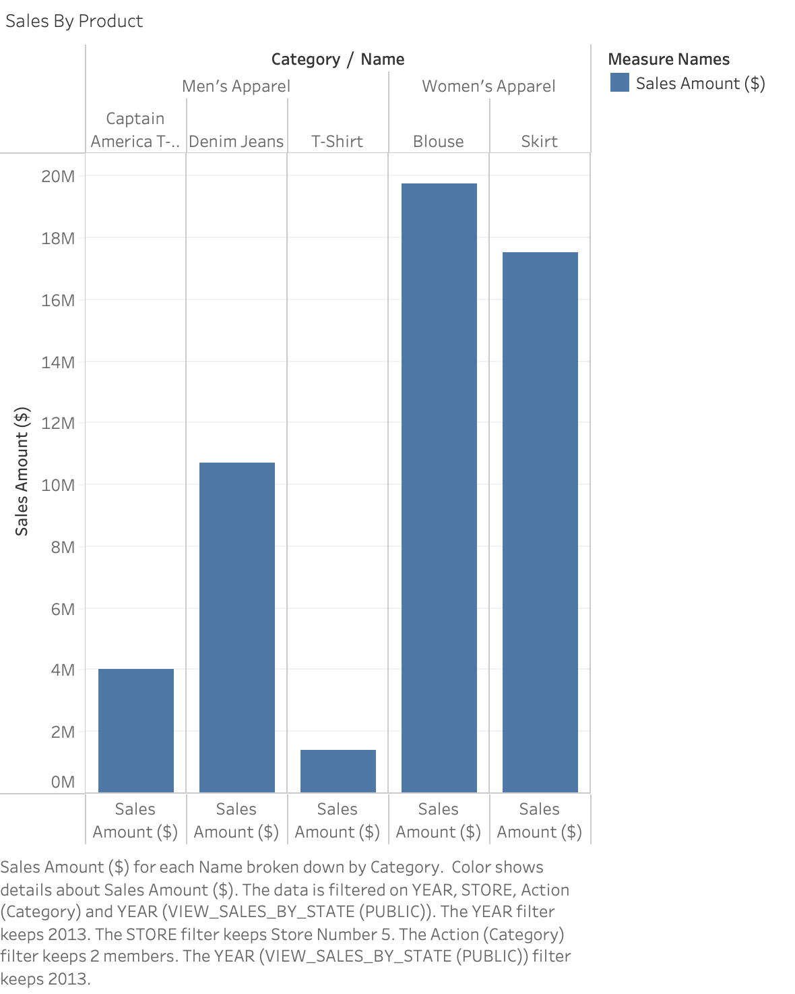

Slide 4
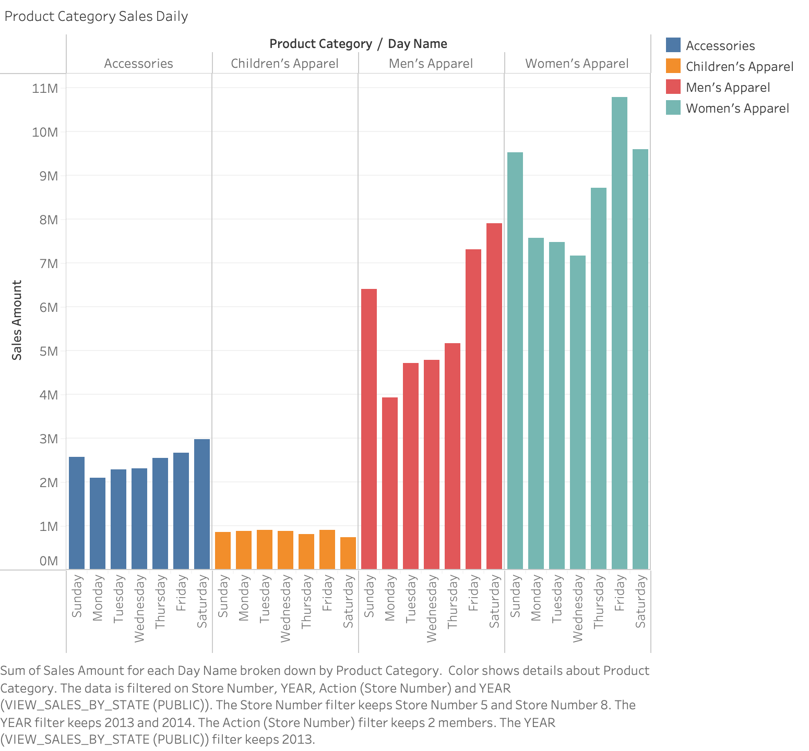

Slide 5
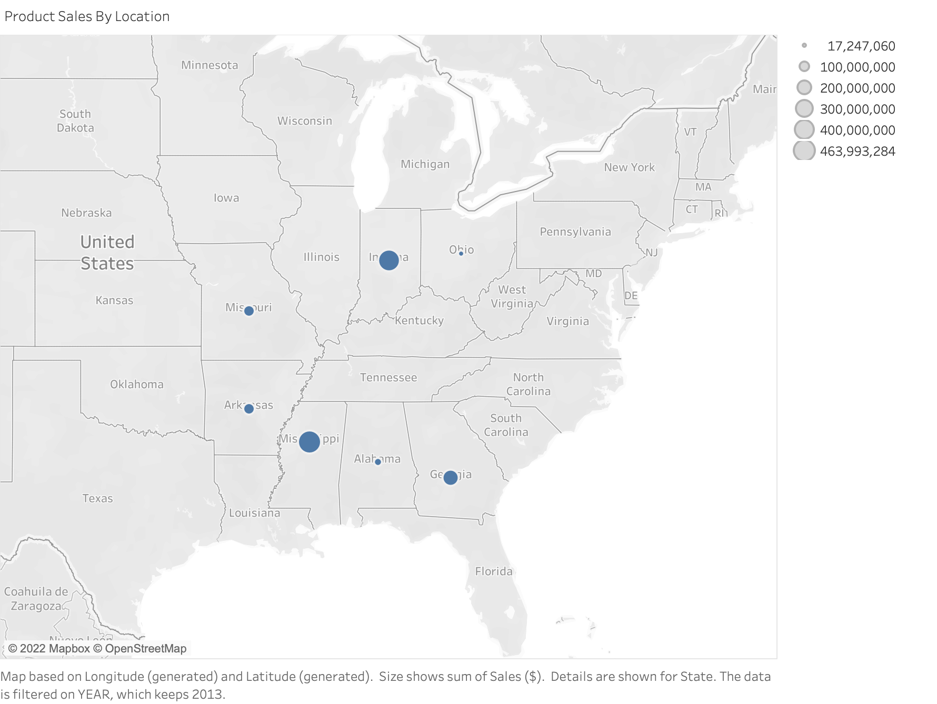

Slide 6
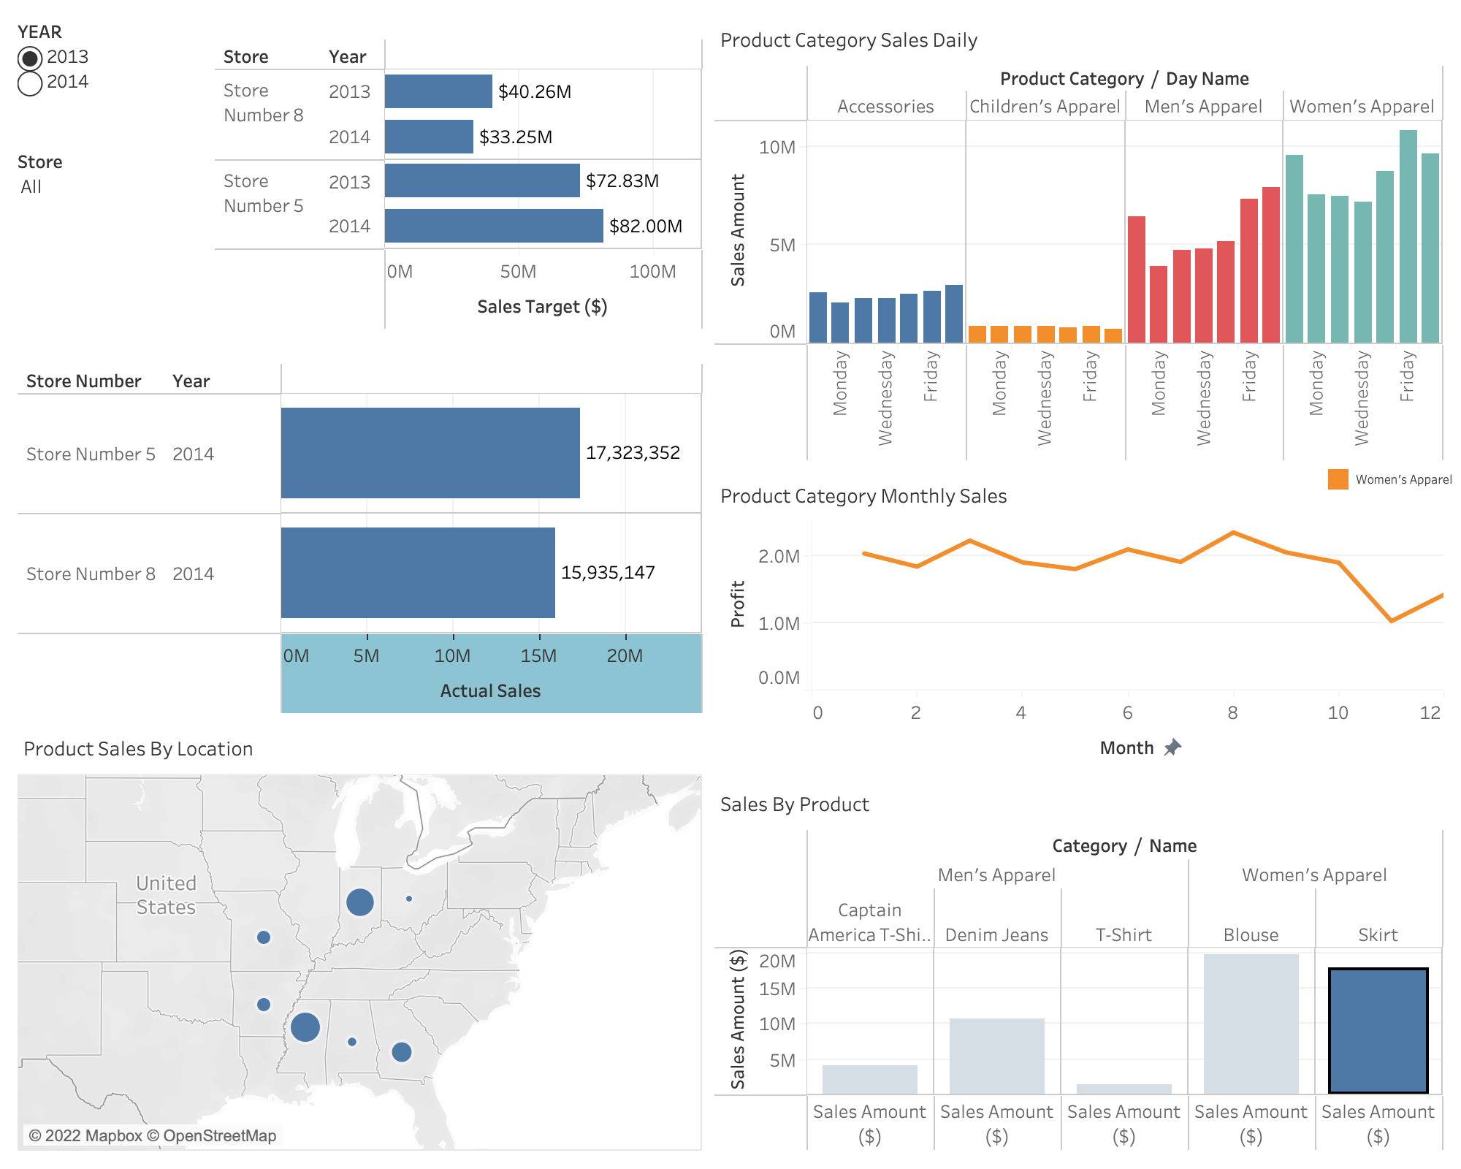

Slide 7
